Slide 1
RSA decryption with Shor’s Algorithm
Cagil Benibol

Slide 2
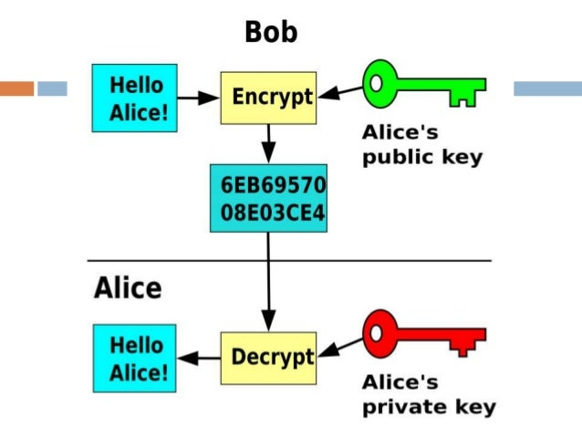
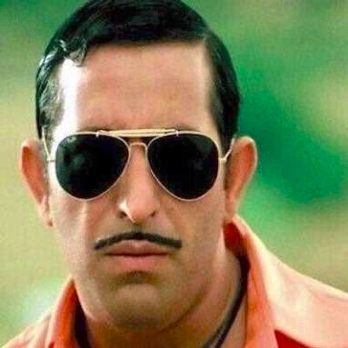

RSA Encryption
Arif
We have to
escape
Bob
Ne sucuk
yapmis
We have to
escape

Slide 3
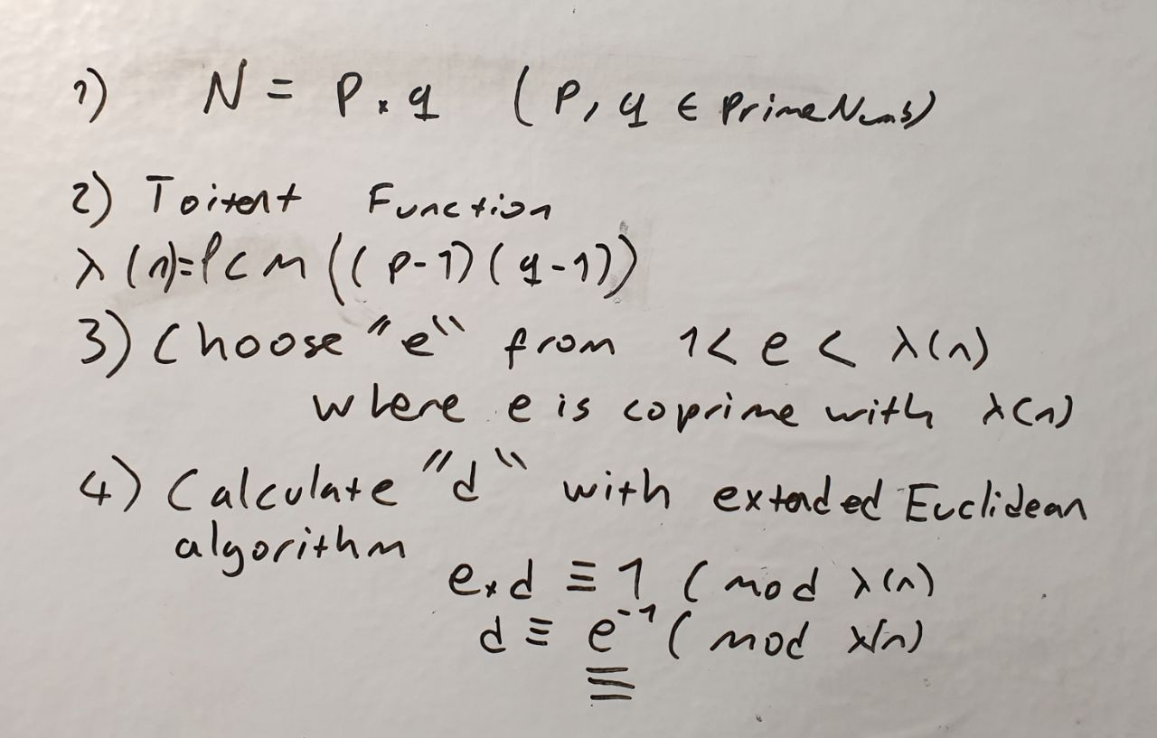
Steps for RSA

Slide 4
Extended Euclidean algorithm
def eea(a,b):
if(a%b==0):
return(b,0,1)
else:
gcd,s,t = eea(b,a%b)
s = s-((a//b) * t)
print("%d = %d*(%d) + (%d)*(%d)"%(gcd,a,t,s,b))
return(gcd,t,s)

Slide 5
Encrypting
Public_key = (e,n)
def encrypt(pub_key,message):
e,n = pub_key
asciiarr = to_ascii(message)
crypted_m=[]
for i in asciiarr:
cm=((int(i)**e) % (n))
crypted_m.append(cm)
return crypted_m

Slide 6
Decrypting
Private_key = (d,n)
def decrypt(priv_key,message):
d,n = priv_key
txt=message.split(',')
asciiarr=[]
print(txt)
for i in txt:
dm=((int(i)**d) % (n))
asciiarr.append(dm)
return from_ascii(asciiarr)

Slide 7
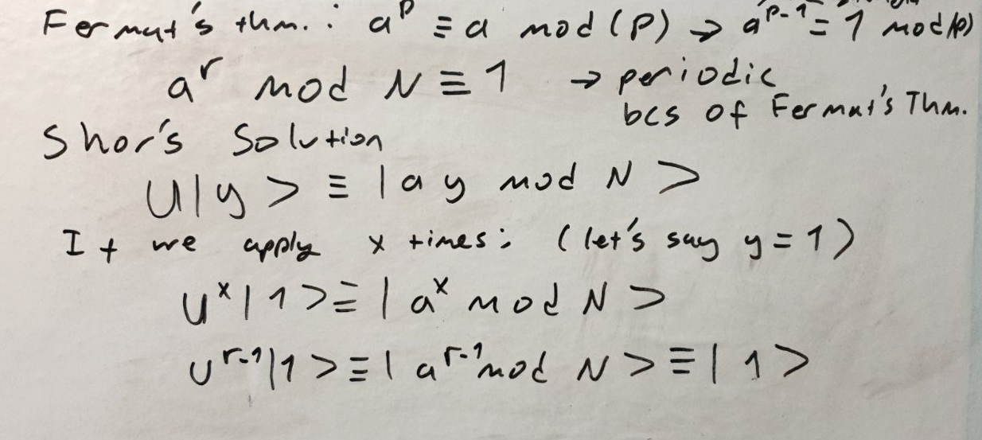
Shor’s Algorithm

Slide 8
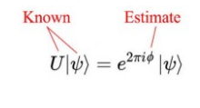
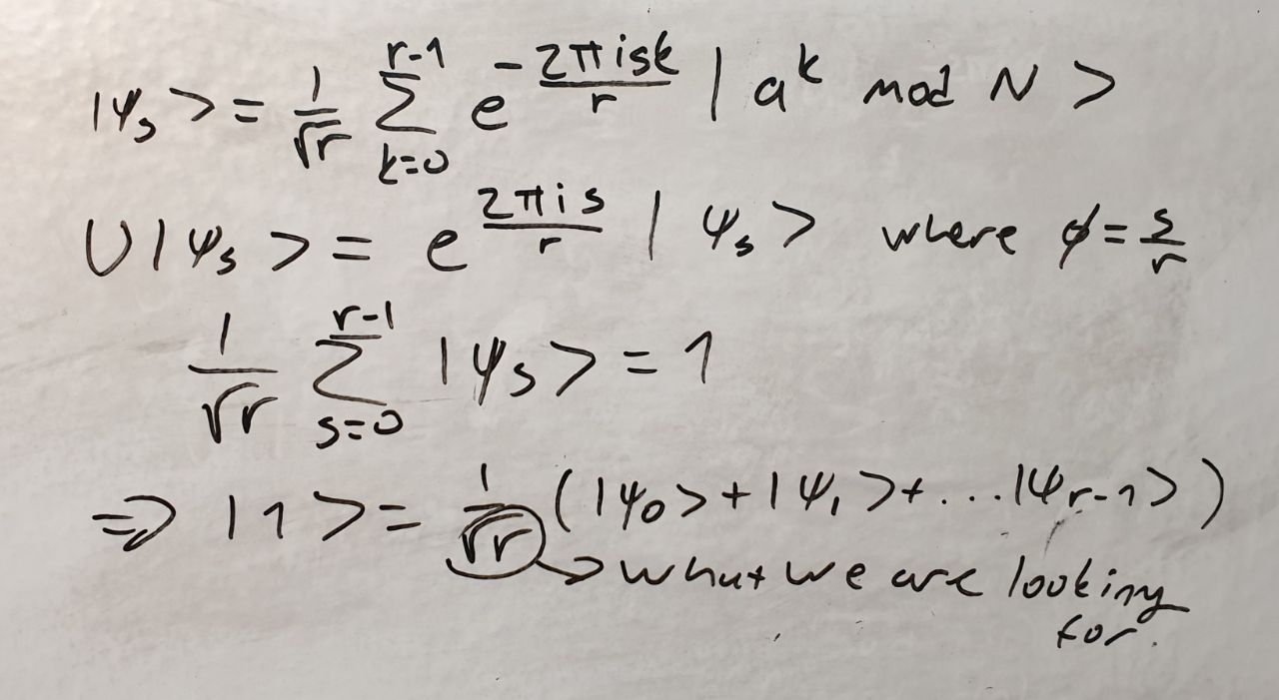
Phase Estimation

Slide 9
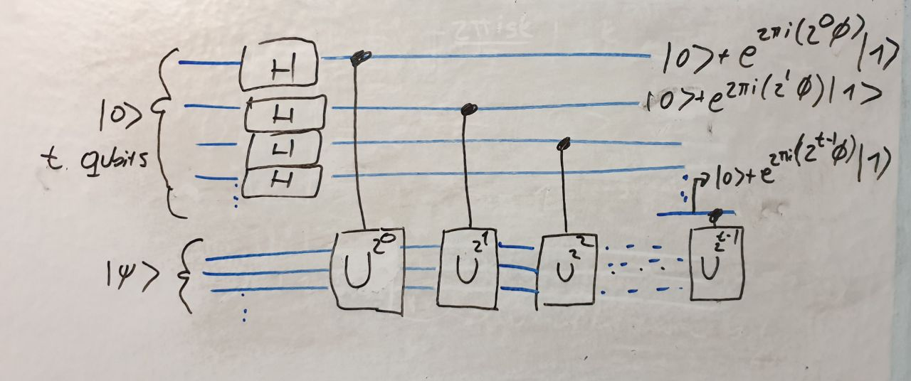
Designing Circuit

Slide 10
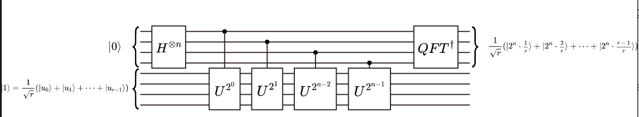
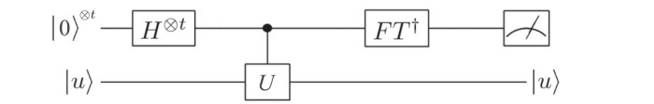
Retrieved from qiskit.org notebook

Slide 11
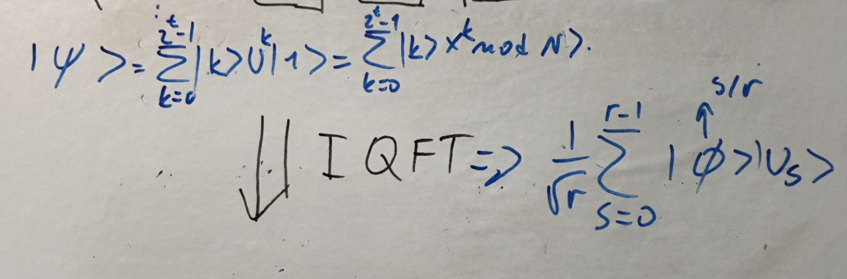

Slide 12
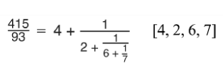
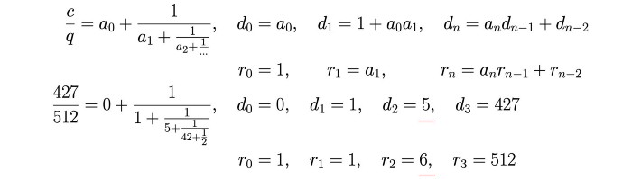
Fraction Algorithm
. d should be coprime with r
. r should be even
Retrieved from https://jonathan-hui.medium.com

Slide 13
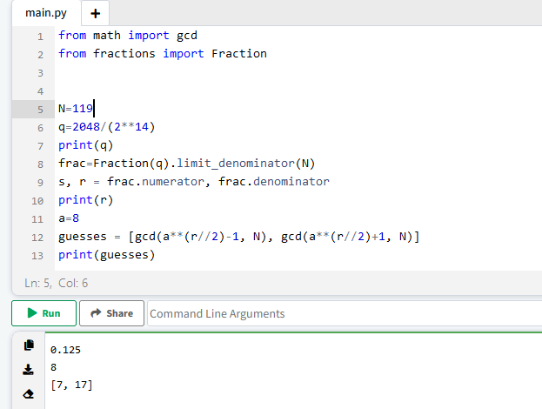
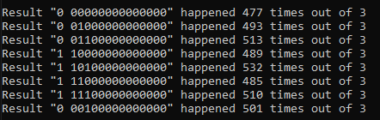

Slide 14
------> Analysing result 00100000000000. This result happened in 16700.0000 % of all cases
In decimal, x_final value for this result is: 2048
Running continued fractions for this case
Approximation number 1 of continued fractions:
Numerator:0 Denominator: 1
Odd denominator, will try next iteration of continued fractions
Approximation number 2 of continued fractions:
Numerator:1 Denominator: 8
The factors of 119 are 17 and 7
Found the desired factors!
Using a=8, found the factors of N=119 in 33700.0000 % of the cases
1 = 3*(1) + (-1)*(2)
1 = 5*(-1) + (2)*(3)
1 = 48*(2) + (-19)*(5)
1 = 5*(-19) + (2)*(48)
-19 48 einv, _lambda
29 value d
public key(e,n): (53, 119)
public key(d,n): (29, 119)
[83, 33, 94, 75, 76, 2, 51, 88, 33, 94]
[104, 101, 110, 108, 111, 32, 102, 114, 101, 110]
String: henlo fren
Your decrypted message is: henlo fren
(base) C:\Users\Bilal Emmi\Desktop\qcomp\project>python tets.py
18 val of t, val of n bit length: 7
17 val of qubit numb
input number was: 119
Total number of qubits used: 17
Executing the circuit 3 times for N=119 and a=8
ibmqfactory.load_account:WARNING:2022-01-25 02:26:10,442: Credentials are already in use. The existing account in the session will be replaced.
Printing the various results followed by how many times they happened (out of the 3 cases):
Result "0 00000000000000" happened 477 times out of 3
Result "0 01000000000000" happened 493 times out of 3
Result "0 01100000000000" happened 513 times out of 3
Result "1 10000000000000" happened 489 times out of 3
Result "1 10100000000000" happened 532 times out of 3
Result "1 11000000000000" happened 485 times out of 3
Result "1 11100000000000" happened 510 times out of 3
Result "0 00100000000000" happened 501 times out of 3

Slide 15
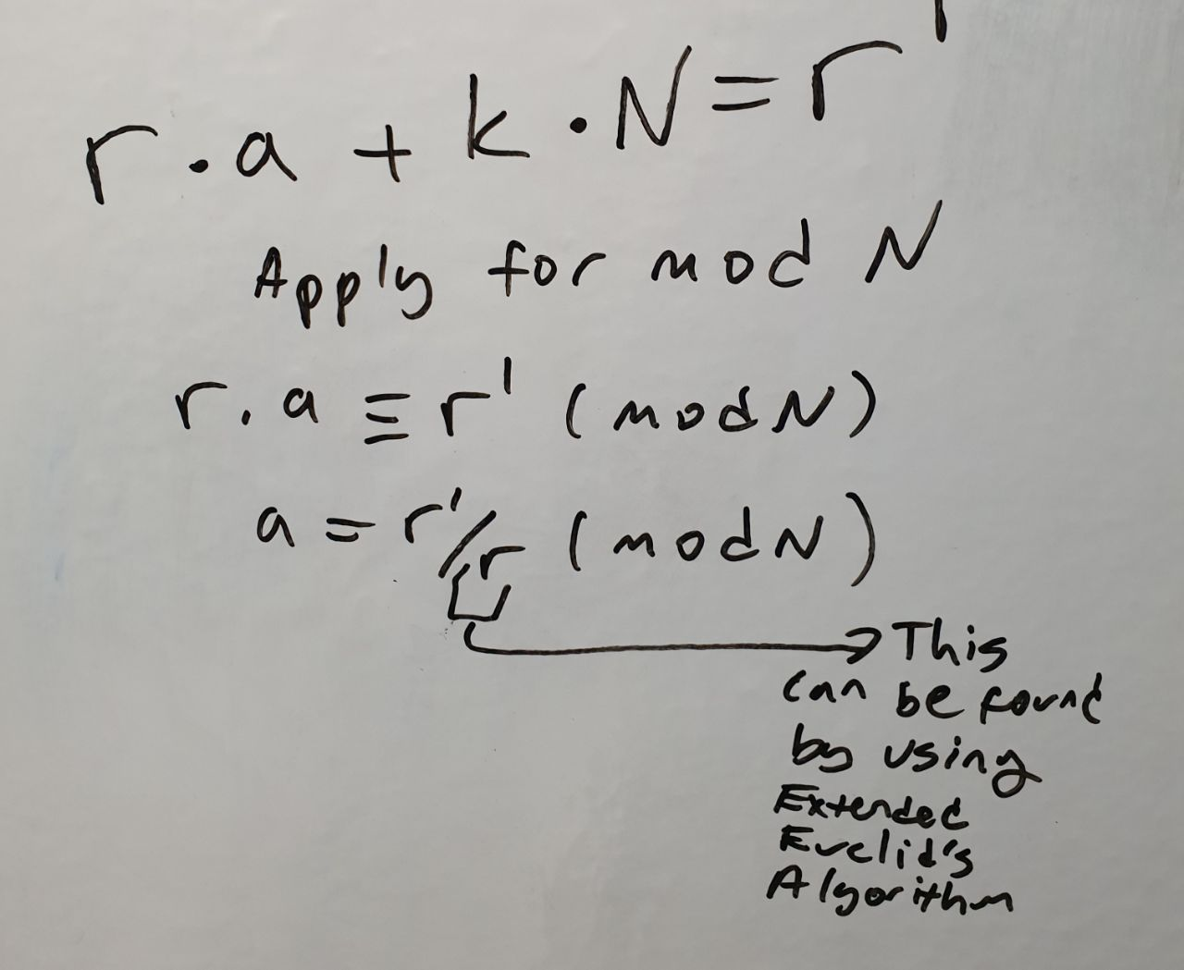
Qubit Count
n=math.ceil(math.log2(val))
bit_n=2*n+3
Is it possible to
use smaller qubits?
( Shor’s algorithm with fewer
(pure) qubits, Christof Zalka , 2008)

Slide 16
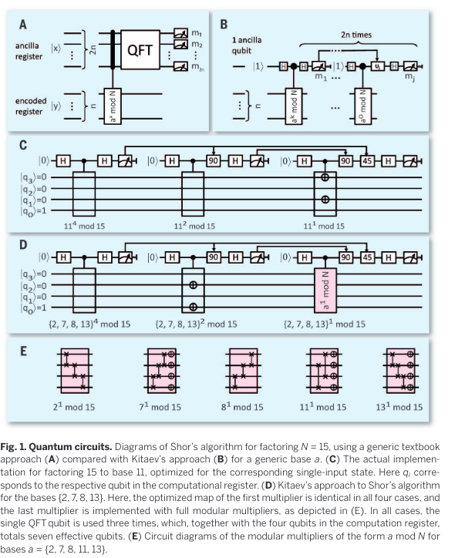
Realization of a scalable
Shor algorithm, Monz et al., 2016
Certain algorithms for quantum computers are able to outperform their classical counterparts.
In 1994, Peter Shor came up with a quantum algorithm that calculates the prime factors
of a large number vastly more efficiently than a classical computer. For general scalability of
such algorithms, hardware, quantum error correction, and the algorithmic realization itself
need to be extensible. Here we present the realization of a scalable Shor algorithm, as proposed
by Kitaev. We factor the number 15 by effectively employing and controlling seven qubits
and four “cache qubits” and by implementing generalized arithmetic operations, known as
modular multipliers. This algorithm has been realized scalably within an ion-trap quantum
computer and returns the correct factors with a confidence level exceeding 99%
https://sci-hub.se/10.1126/science.aad9480

Slide 17
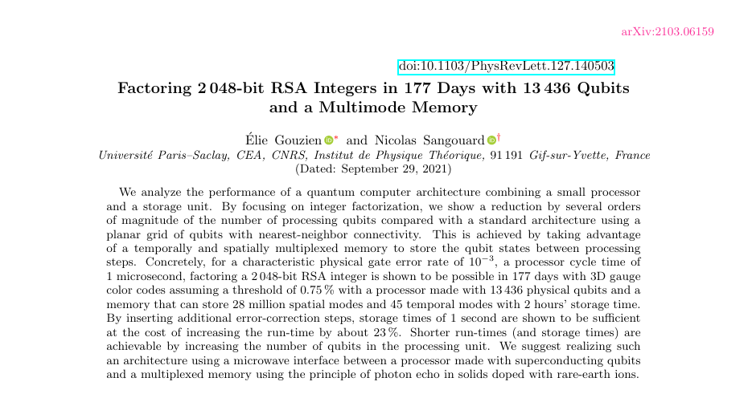

Slide 18
References
https://hal.archives-ouvertes.fr/hal-03358148/document
https://www.science.org/doi/10.1126/science.aad9480
https://arxiv.org/pdf/quant-ph/0601097.pdf
https://qiskit.org/documentation/stable/0.26/_modules/qiskit/aqua/algorithms/factorizers/shor.html
https://github.com/ttlion/ShorAlgQiskit
https://qiskit.org/textbook/ch-algorithms/shor.html
https://young.physics.ucsc.edu/150/shor.pdf
https://jonathan-hui.medium.com/qc-period-finding-in-shors-algorithm-7eb0c22e8202
https://www.codespeedy.com/rsa-algorithm-an-asymmetric-key-encryption-in-python/
Kriptografiye Giris, Erkan Afacan ,epos 2016

Slide 19
My Github Repository
For further questions you can look up the codes that I made for this project and you can apply it own your own.
https://github.com/Tihulu/quantumcomputing

